Slide 1
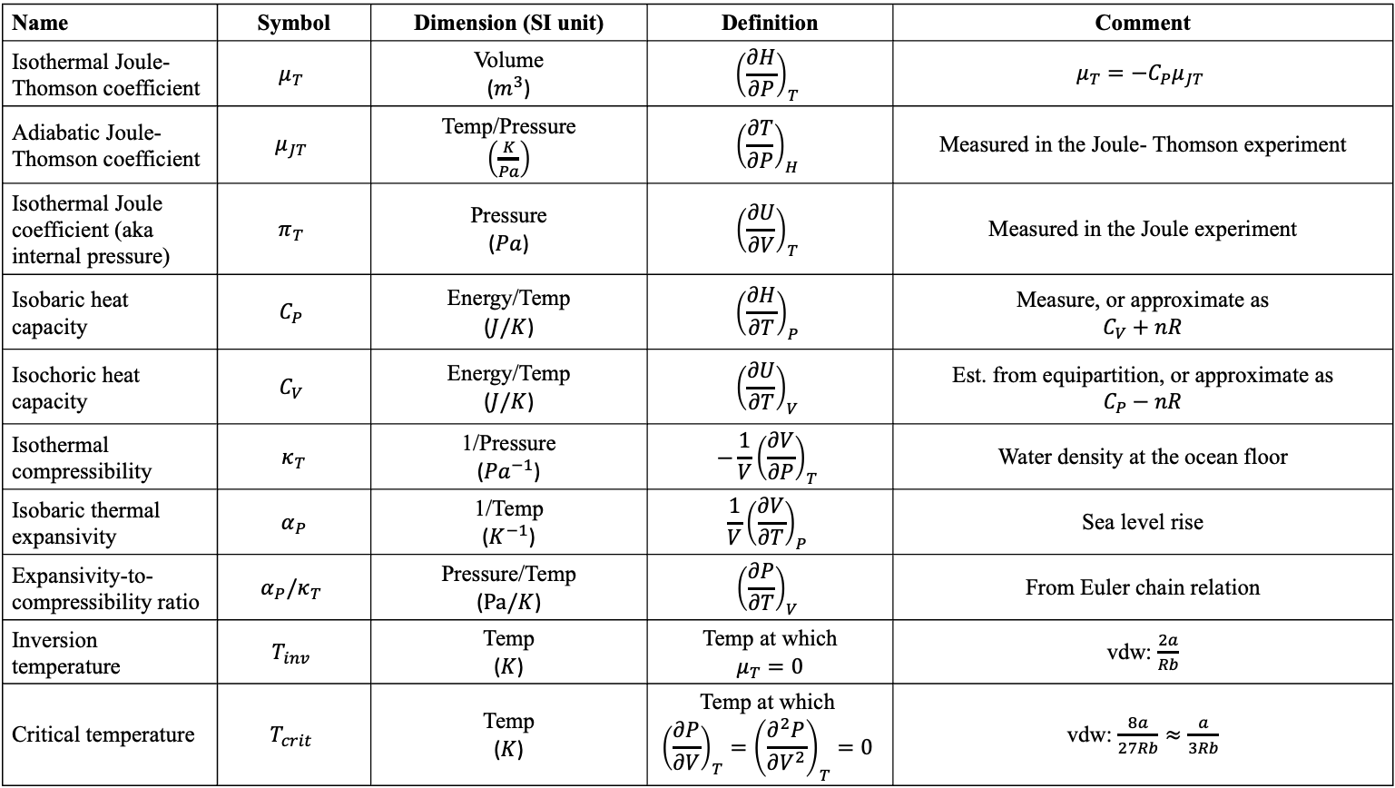
Summary of measurable quantities
Name | Symbol | Dimension (SI unit) | Definition | Comment
Isothermal Joule-Thomson coefficient | $$μ_{T}$$ | Volume ($m^{3}$) | $${\left(\frac{∂H}{∂P}\right)}_{T}$$ | $$μ_{T}=−C_{P}μ_{JT}$$
Adiabatic Joule-Thomson coefficient | $$μ_{JT}$$ | Temp/Pressure $\left(\frac{K}{Pa}\right)$ | $${\left(\frac{∂T}{∂P}\right)}_{H}$$ | Measured in the Joule- Thomson experiment
Isothermal Joule coefficient (aka internal pressure) | $$π_{T}$$ | Pressure ($Pa$) | $${\left(\frac{∂U}{∂V}\right)}_{T}$$ | Measured in the Joule experiment
Isobaric heat capacity | $$C_{P}$$ | Energy/Temp ($J/K$) | $${\left(\frac{∂H}{∂T}\right)}_{P}$$ | Measure, or approximate as $$C_{V}+nR$$
Isochoric heat capacity | $$C_{V}$$ | Energy/Temp ($J/K$) | $${\left(\frac{∂U}{∂T}\right)}_{V}$$ | Est. from equipartition, or approximate as $$C_{P}−nR$$
Isothermal compressibility | $κ_{T}$ | 1/Pressure (${Pa}^{−1}$) | $$−\frac{1}{V}{\left(\frac{∂V}{∂P}\right)}_{T}$$ | Water density at the ocean floor
Isobaric thermal expansivity | $α_{P}$ | 1/Temp ($K^{−1}$) | $$\frac{1}{V}{\left(\frac{∂V}{∂T}\right)}_{P}$$ | Sea level rise
Expansivity-to-compressibility ratio | $$α_{P}/κ_{T}$$ | Pressure/Temp ($Pa/K$) | $${\left(\frac{∂P}{∂T}\right)}_{V}$$ | From Euler chain relation
Inversion temperature | $$T_{inv}$$ | Temp ($K$) | Temp at which $$μ_{T}=0$$ | vdw: $\frac{2a}{Rb}$
Critical temperature | $$T_{crit}$$ | Temp ($K$) | Temp at which $${\left(\frac{∂P}{∂V}\right)}_{T}={\left(\frac{∂^{2}P}{∂V^{2}}\right)}_{T}=0$$ | vdw: $\frac{8a}{27Rb}≈\frac{a}{3Rb}$

